Slide 1
https://education.nsw.gov.au/hr-payroll-program

Slide 2
1. WHY?
Why are we changing our HR Payroll systems?
The current HR Payroll system is over 20 years old and has reached the end of its serviceable life.
The department is moving to a flexible, up-to-date SAP based system with all the familiar features of the current system.
It has been designed to serve us now and into the future.
Notes:
The system we are using is over 20 years old and as you are aware, technology is evolving all the time. In order to ensure that 130,000 staff members get paid every fortnight, we need to update the system before it breaks down.
With the advancing technology, we are moving to a system that will be accessible on a tablet and mobile phone.

Slide 3
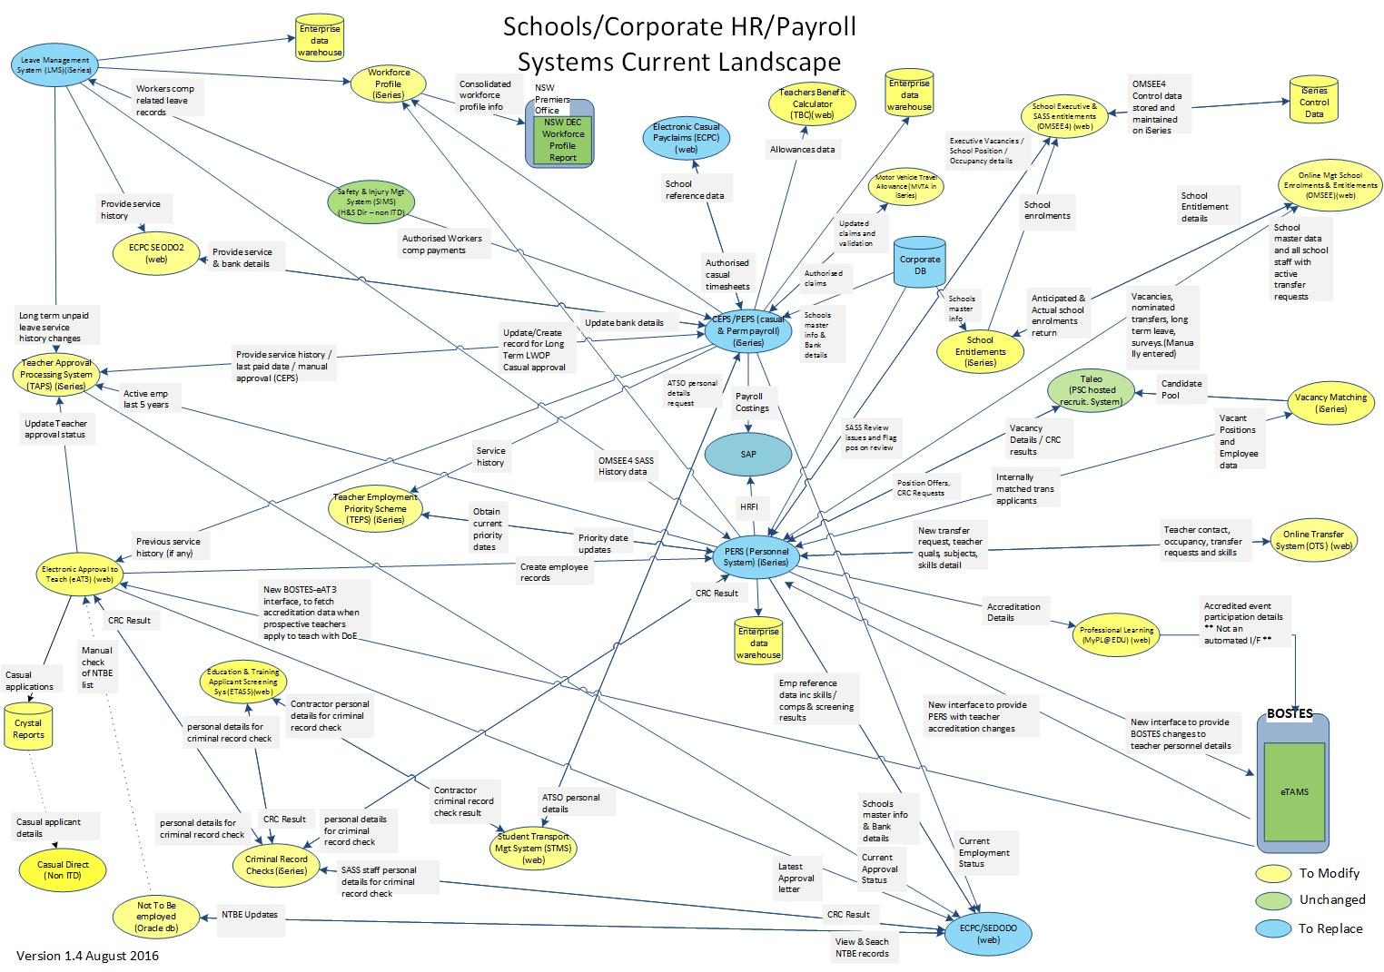
HR payroll program is replacing 5 legacy systems
We are replacing:
CEPS – casual payroll
PEPS – permanent payroll
eCPC – casual pay claims
leave management
Motor Vehicle Travel Allowance [MVTA]
We are also remediating system-to-system connections.
4
3
5
1
2
3
Notes:
Currently there is a spaghetti web of multiple systems being operated within the department. SAP HR Payroll will be replacing 5 systems
We are replacing:
CEPS – casual payroll
PEPS – permanent payroll
eCPC – casual pay claims
leave management
Motor Vehicle Travel Allowance [MVTA]

Slide 4
2. WHAT?
What does this mean for you?
The new HR Payroll system will continue to provide seamless delivery of your pay with the same self-services that you have today.
All staff will experience new and improved ways to manage HR Payroll matters:
Online employee self-services to view additional personal information and new ways to notify changes in arrangements.
Online manager self-services to assist with people, time and leave management.
More efficient and improved ways to claim travel and expenses.
Workflow-based HR payroll systems and approval..
Notes:
The New HR Payroll system will give each and everyone of you online access to employee self-service to view and update your personal information.

Slide 5
Employee Self-Service features of the New SAP HR Payroll
Before Go Live
Manage personal information
Access payslips and payment summaries
Manage leave
Equal employment opportunity [EEO]
After Go Live
Manage personal information
Access payslips & payment summaries
Manage leave including non-attendance
Equal employment opportunity [EEO]
New self-services
View employment history
Display superannuation
Manage family/dependent details
Record working time (excluding flex)
Manage travel and expenses
Accept/decline temporary engagement

Slide 6
Manager Self-Service features of the New SAP HR Payroll
Before Go Live
Approve staff leave
View staff leave history
After Go Live
Approve leave, time, travel & expenses
New self-services
View team overview & reminder of dates
Act on behalf of an employee
Manage leave, record working time (excluding flex), change part time work schedule, staffing
Manage organisational structure
Record and reconcile non-attendance
Staffing
temporary staff movement, long-term engagement, casual and short-term nomination
Manage delegation of authority
Manage Industrial Action
HR payroll management reports: employee data, leave, time and pay

Slide 7
3. WHEN?
When will the NEW HR Payroll system be implemented?
Release One – 1 February 2018 All corporate staff and 32 schools, approximately 6,500 employees (5%).
Release Two – March 2018 New employee and manager self-service functionality
Release Three – 26 April 2018 Non-metro schools, approximately 45% of DoE employees.
Release One – 24 May 2018 Metro schools and Assisted Travel Support Officers (ATSOs), remaining 50% of DoE employees.
Notes:
Rescheduling Go Live for the first release of HR Payroll
Our top priority is to ensure all departmental employees are paid correctly and on time. To ensure this occurs, the program has conducted testing including parallel pay run and user acceptance testing. While the results indicate that we are almost ready, additional tests will ensure the transition is as smooth as possible.
The decision has therefore been made to Go Live with the first release on 1 February 2018. The scheduled implementation dates for the three subsequent releases have not changed and the target completion date remains 30 June 2018.
This date change will not affect your current work and pay. You are not required to perform any immediate tasks. Please ask any questions on ‘Our New HR Payroll system’ Yammer page.
As leaders of change, we are asking managers and principals to download the Rescheduled Go Live leader-led template and use this to keep their teams informed. This content can be used as an email or read out at a staff meeting. Additional leader-led resources will be produced to help managers and principals regularly update their teams.
We remain committed to delivering an effective SAP HR Payroll system which meets the needs of the department and will continue to update you with the progress.
Rescheduling Go Live for the first release of HR Payroll
Our top priority is to ensure all departmental employees are paid correctly and on time. To ensure this occurs, the program has conducted testing including parallel pay run and user acceptance testing. While the results indicate that we are almost ready, additional tests will ensure the transition is as smooth as possible.
The decision has therefore been made to Go Live with the first release on 1 February 2018. The scheduled implementation dates for the three subsequent releases have not changed and the target completion date remains 30 June 2018.
This date change will not affect your current work and pay. You are not required to perform any immediate tasks. Please ask any questions on ‘Our New HR Payroll system’ Yammer page.
As leaders of change, we are asking managers and principals to download the Rescheduled Go Live leader-led template and use this to keep their teams informed. This content can be used as an email or read out at a staff meeting. Additional leader-led resources will be produced to help managers and principals regularly update their teams.
We remain committed to delivering an effective SAP HR Payroll system which meets the needs of the department and will continue to update you with the progress.

Slide 8
4. NOW WHAT?
What do you need to do now?
Update your personal details in ESS to ensure you get paid now and into the future
Check and download your payslips to ensure your pay and entitlements are correct. If they are not please contact EDConnect on 1300 32 32 32
Notify peers of the HR payroll system change and encourage them to take action
Notes:
Update your profile on the portal home page Modify ESS My details Address postal address personal email emergency contact
Change your DDS entry from ESS My details
Check your banking details Save new balances for your leave from ESS @ 10 November 2017 Approve/process/reject HR related activities SAP Finance
Shopping carts
Accounts receivable
Accounts payable
Master data
Approval workflows
Note Pay cycle is unchanged
https://education.nsw.gov.au/human-resources/news-and-communications/casual-payroll-change/pay-date-and-cycle

Slide 9
5. WHERE?
Where can you find more information?
Go to the HR Payroll Program on the intranet for comprehensive and important information about the change.
Join the ‘Our NEW HR Payroll System’ Yammer group and collaborate.
HR Payroll Program
Notes:
Update your profile on the portal home page Modify ESS My details Address postal address personal email emergency contact
Change your DDS entry from ESS My details
Check your banking details Save new balances for your leave from ESS @ 10 November 2017 Approve/process/reject HR related activities SAP Finance
Shopping carts
Accounts receivable
Accounts payable
Master data
Approval workflows
Note Pay cycle is unchanged
https://education.nsw.gov.au/human-resources/news-and-communications/casual-payroll-change/pay-date-and-cycle

Slide 10
6. A look into training and system deep-dive
Compare the way it was to the way it will be for:
Unplanned leave
Reconcile non-attendance
Sub Delegate Services
Staffing [coming soon]

Slide 11
Modular Training and support material in multiple formats
e-learning:
Employee and Manager Self-Service modules
Just-in-time training
Formats:
More information
Show Me Videos
How Do I Guides
Notes:
E-Learning
Self paced e-learning modules will be made available to all employees and managers, explaining how to use ESS and MSS functionality
The e-learning is not a prescribed course that needs to be completed from start to finish – instead it is a resource that can be used as and when you need it to learn more about specific functionality as you are using it.
Initial functionality will be explained in three different formats based on learning style – supplementary information, a pre-recorded video demoing the steps and a printable step by step guide.
The elearning modules as they stand are now up on MyPL.
MSS
MSS is in private mode and can only be accessed by the links below:
Non-Doe Users https://mypl.education.nsw.gov.au/q/NR17589
DoE Users https://myplsso.education.nsw.gov.au/q/NR17589
ESS:
DoE staff use the link below https://myplsso.education.nsw.gov.au/q/NR17696
Non-DoE use the link below https://mypl.education.nsw.gov.au/q/NR17696

Slide 12
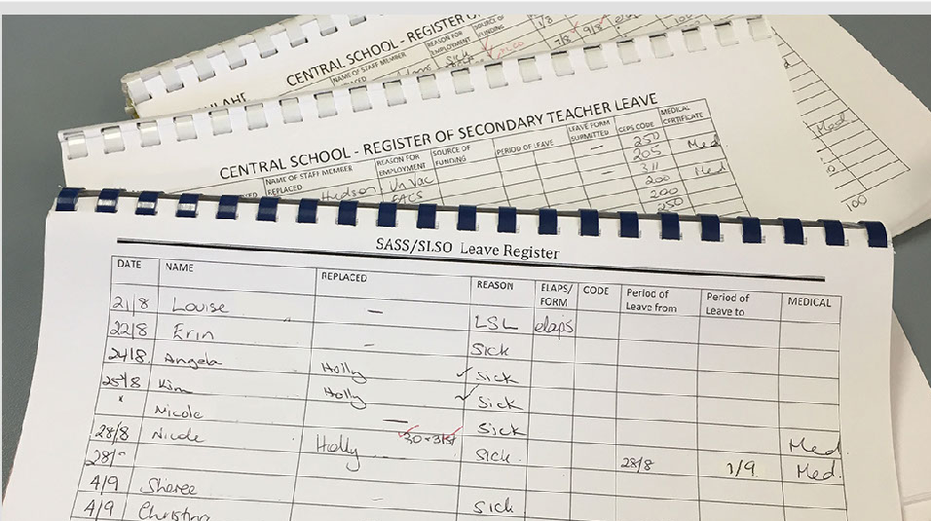
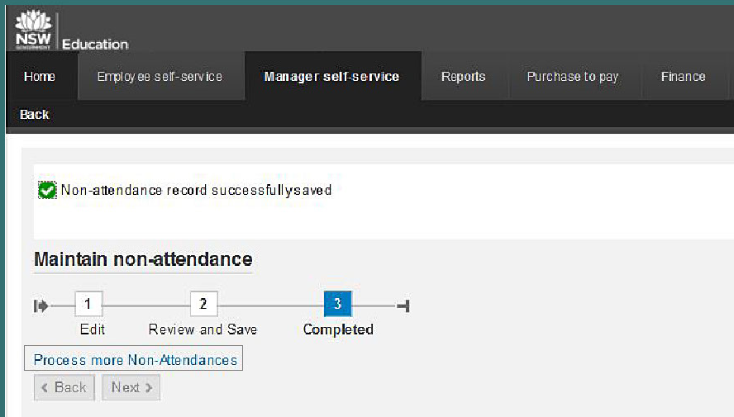
Unplanned leave
Replaces manual forms
Record non-attendance
Staff email reminder sent
21 days to respond
Notes:
BEFORE GO LIVE some employees manually record their absences in Leave Registers.
In some cases, the Principal or allocated staff member may need to remind staff to submit leave requests for approval.
Access is from SAP Portal (NEW) as for Finance
click on the ‘Manager self-service’ tab. Please note only principals and managers have access to this tab.
Then click on ‘Maintain non-attendance’.
Select the staff member for whom you are entering a staff absence.
Select the teacher’s date of absence and then select the duration of the absence from the drop-down menu: a full day or less.
To enter less than a day for administrative and support staff, select ‘Enter partial day’ and enter the duration of absence in hours and minutes.
Select the date of absence for the School Administrator Officer and tick the box to enter a full day.
Select ‘Next’ to move to the ‘Save’ page.
Check the absence details entered in ‘Review and Save’. If correct, select ‘Save’. Note: If you need to add in another staff member’s absence, you can add that on the next screen.
You can enter more staff details by selecting. ‘Process more non-attendances’ or Select ‘Next’ to finish. You will receive confirmation that the absence details have been recorded.
After the absence details are recorded, an email will be sent to the staff member to request submission of the leave application for the period of non-attendance.
A reminder email is sent seven days later if the staff member hasn’t submitted the leave application.

Slide 13
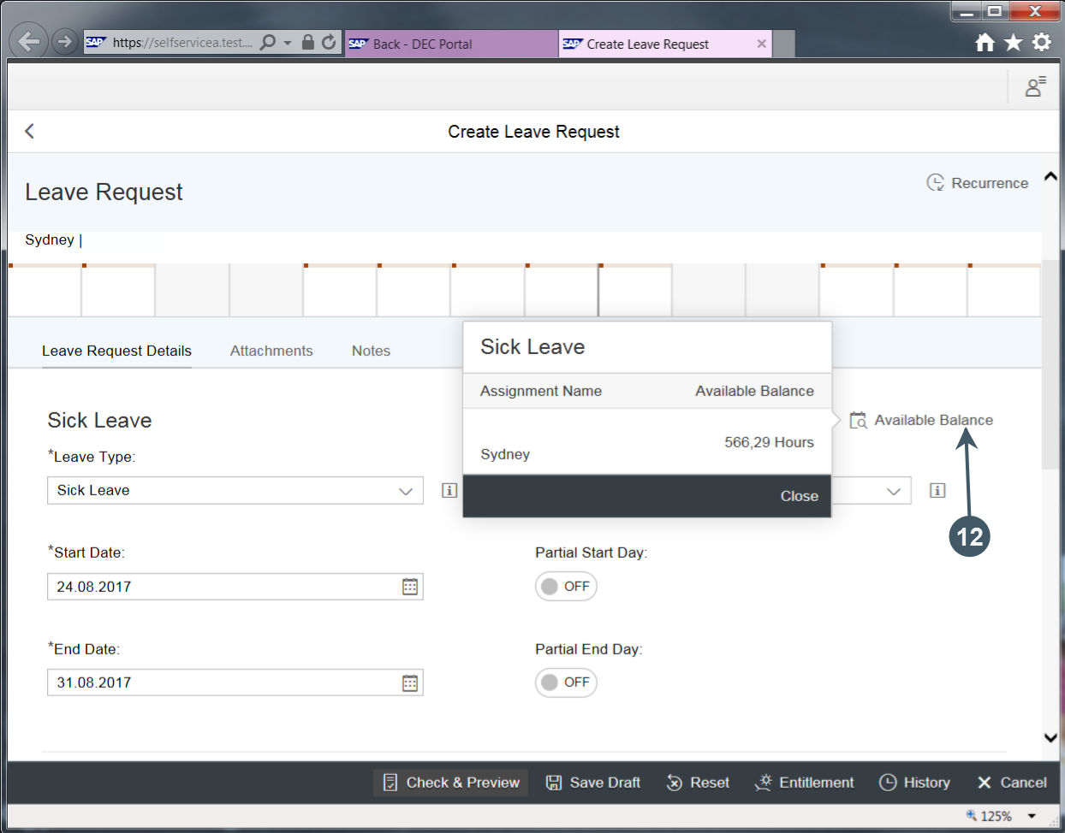
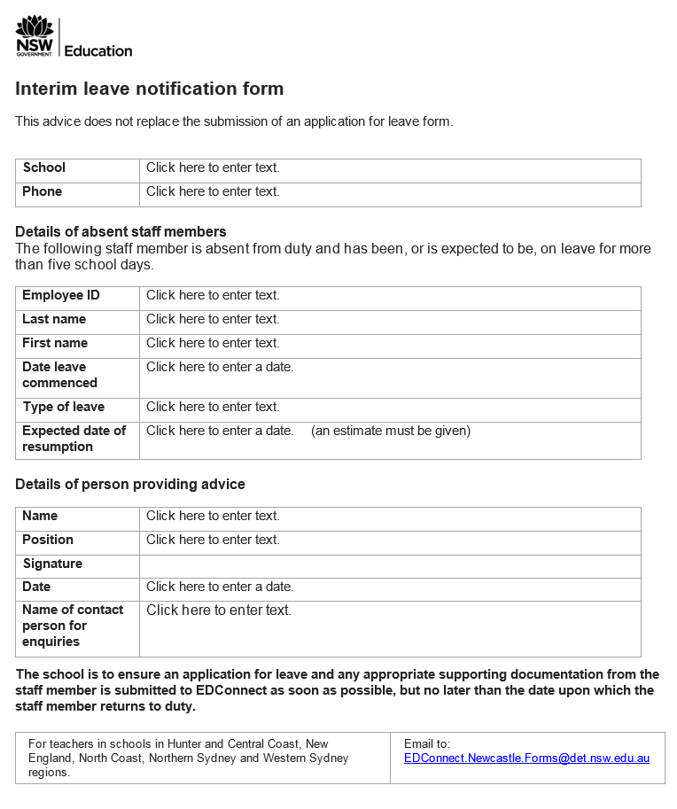
Reconcile non attendance
Email received
Staff email reminder sent
21 days to respond
Notes:
Previously STAFF were expected to lodge a leave request when they return to work.
If forgotten, there was a constant checking and reminding of staff to input leave request. A very time consuming task for the HT Admin or SAM.
Now if a non attendance is recorded by the Principal or delegate, the staff member receives an email requesting them to put submit a leave request. A reminder email is sent after 5 days. After 21 days, the day of leave is recorded as a unauthorised absence and the staff member’s pay is adjusted accordingly.
Mention interim leave form
Email received
ESS
Create leave request against the dates in email.

Slide 14
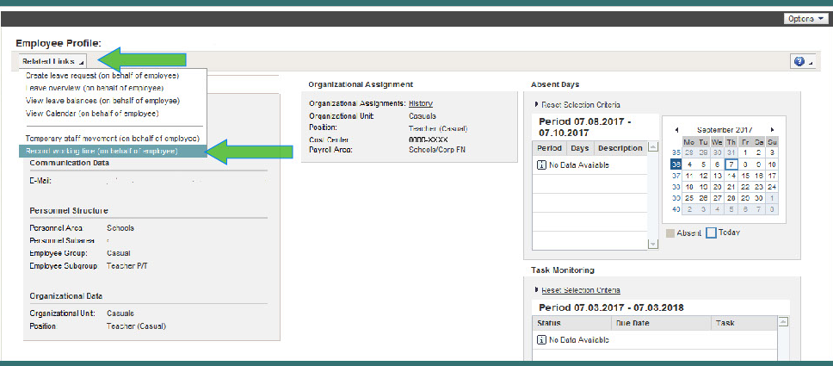
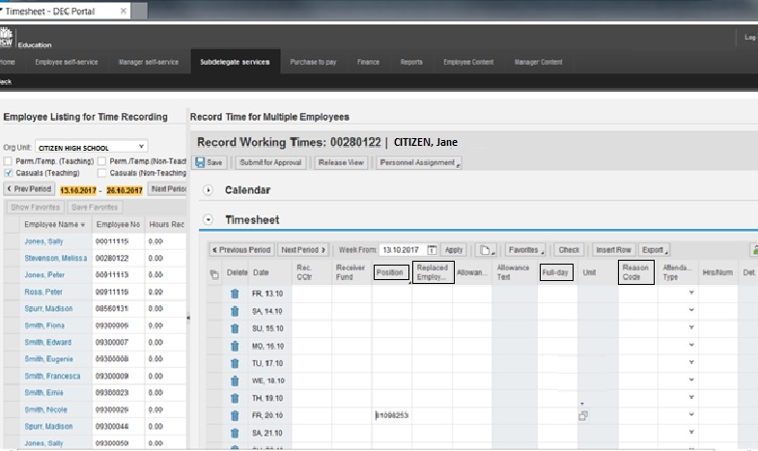
Casual timesheeting
Replaces manual forms & e-CPC
Casual or delegate can initiate
Confirmation email sent
Notes:
SDS/MSS
Under Team/ quick link - Employee information
Highlight staff member – may need to expand team information grouping
Employee Profile
Related links
Record working times – can change date of timesheet and can update as the fortnight goes by repeating the process
Enter replaced employee if known and full-day column – yes or no – enter equivalent hours if necessary
Click check – other codes upload (defaults to the standard and change cost centre/fund code if required
Check/save and submit for approval

Slide 15
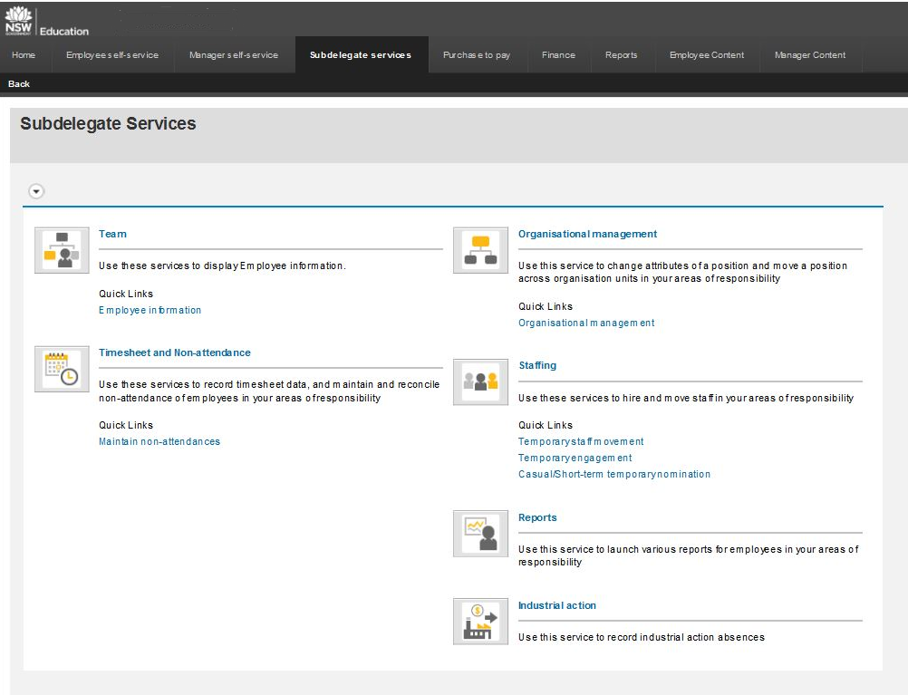
SUB Delegation Services
Providing the delegation of authority to initiate and/or approve:
Leave requests
Time [Timesheet and non-attendance]
Reports
Staffing [Release 2]
This can be provided to anyone within your hierarchy, it is provided at the discretion of Managers /Principals
All the steps to use the functionality are the same except for timesheeting
Notes:
SDS is a function that can be delegated by the Principal to anyone within the school organisational structure. It can be delegated to more than one persona and the delegation is a local decision that is decided by the Principal, school executive and the Business Manager/SAM. Obviously, it is not compulsory that you as SAM is given delegation. That is a decision made with you and your principal. I will however highlight some of the aspects that can be done.
Leave requests
Team
Employee information
Select staff member
Employee profile
Related links Create leave request (OBOE)
Leave overview (ONBE)
View leave balances (OBOE)
View calendar (OBOE)
temporary staff movement (OBOE)
record working time(OBOE)
manage work schedule(OBOE)
Time

Slide 16
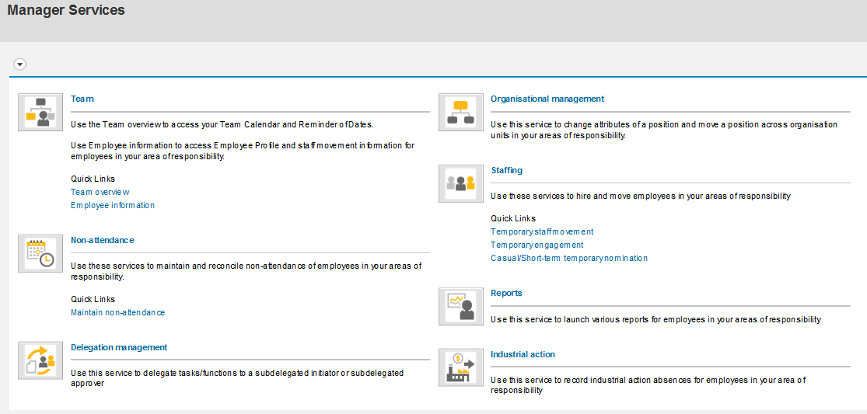
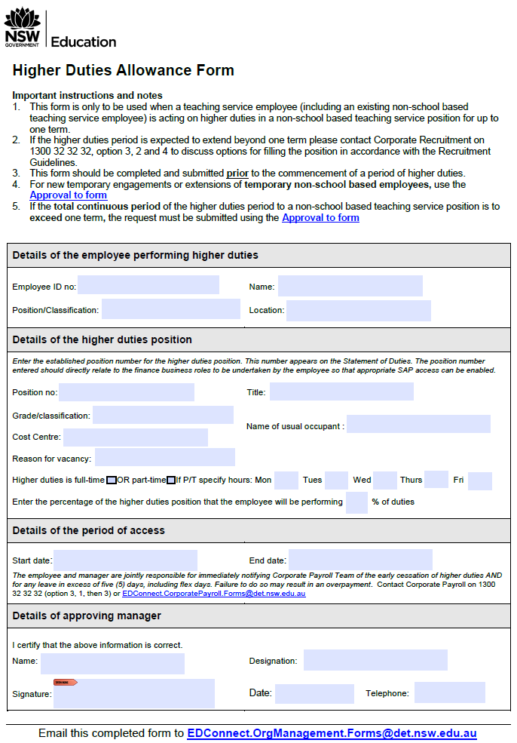
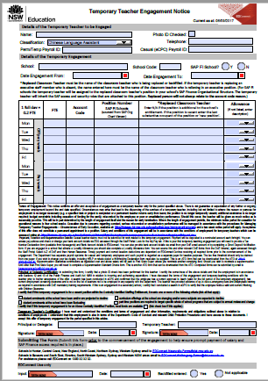
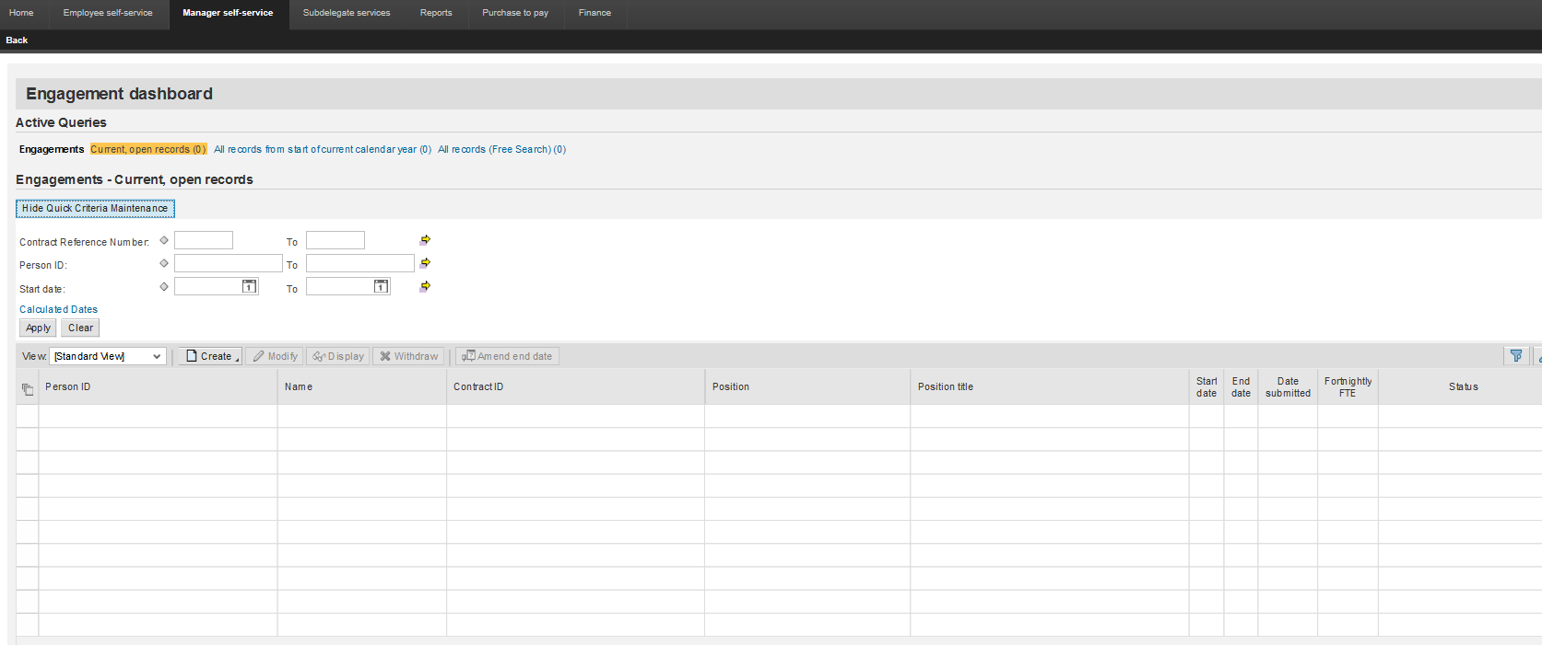
Staffing
After March 2018 upgrade – Replaces manual forms temp engagement and higher duties forms.
Notes:
Not available until the system upgrade at the end of May 2018 but will be available by the time most of you are on system
The area is used to hire and move employees in your area of responsibility
Temp staff movement
temp engagement
casual/short term temp nomination
Higher duties can initiate
Temp accept/decline

Slide 17
QUESTIONS FROM PREVIOUS CONFERENCE
Will staff be able to access an Emergency contact list?
How will I engage a new casual employee?
What training will be given to schools?
When will new temporary engagement forms be out?
Will the payslip show a breakdown of additional hours?
Can I change the G/L codes if error is made?
Will be use CEPs codes?
Notes:
Reports accessible in New SAP
All assignments, appointments, emergency contacts, employee profile, monitoring tasks (eg temps, new hire, return from leave, entry on duty)
Establishment, leave balances, leave overview, monitoring of sick leave, rec leave in excess of 30 days, timesheet details, unauthorised absence, work schedule
New casuals that have worked in the last 5 years will be migrated into the SSHR holding bay. Casuals can be searched for by ID no or name as is today.
New to the business casuals, HR are working on a new form, similar to temporary engagement form so information will be provided. Banking form and TFD will need to be sent in with the new form.
Training will be give to Principals across the state prior to the system rollout for payroll. Likely April and May of next year. Look at HR Payroll on the intranet as there is already user stories which focus on what will happen in the future and also playbooks showing the current state on the left side/the future state on the right. E-learning will be available on myPL but you won’t have to register etc. Show
https://myplsso.education.nsw.gov.au/q/NR17589
Temporary engagement / allowance documentation link was in SchoolBiz last Friday so the process can be completed.
Payslip breakdown – payslip will show casual, additional, temporary assignments
Lists assignment, position, location, classification level, award status
Then breaks the assignment earnings up
Shows full taxation and deductions
There is a report that can be printed prior to the payroll run whereby you can review your costings to make sure the charges comes out of the correct bucket. Amendments can be made for that pay period or for a period of time eg. Casual being paid against Norta Norta funds, changes can be made into system

