Slide 1
Leadership and high performance directorate
supporting SAS staff and schools in a time of change
SAM Conference 3 November 2017
SAS staff Reference Group Macquarie Park
Notes:
Good morning
My name is Julie Sando and I am a Development Officer for the Excellence in School Administration Strategy.
I work within the Leadership and High Performance Directorate located in Oxford Street in Sydney
I am supported by a team of Development Officers working across all Operational Directorates to support SAS staff state-wide.

Slide 2
Excellence in school administration (ESA) strategy
The three elements of the ESA strategy are:
framework
online resources
coaching and mentoring
Notes:
The Excellence in School Administration Strategy has been developed to enhance the administrative capacity of schools and focuses on the professional development of SAS staff in all school settings.
The three elements of the ESA strategy are:
The framework
Online resources which include e-learning modules and presentations
and a coaching and mentoring program

Slide 3
ESA Framework
supports leadership growth for aspiring administrative leaders
assists SRGs and schools to plan professional development for non-teaching staff
describes quality customer relationships and administrative practices
Notes:
The ESA framework describes the essential attributes of customer relationships and administrative practices
The framework will assist SRGs and schools to plan professional development for non-teaching
The framework also supports leadership growth for aspiring administrative leaders
The framework and associated online resources will be helpful when starting on your Performance Development Plans.

Slide 4
ESA Resources
10 modules support quality customer relationships
8 modules to support administrative practices
all modules will be available to be used by a group PowerPoint or individual e-learning
the relationships modules are now available on the Professional Learning website. The Administrative Practices will be available later this year.
Notes:
A suite of resources are being developed in both PowerPoint and e-learning which will be accessible for all staff.
There are 10 modules to support quality customer relationships and 8 modules to support admin practices

Slide 5
Notes:
The first aspect of the framework focuses on customer relationships within schools and describes the essential attributes of quality customer relationships

Slide 6
Notes:
The second aspect of the framework covers administrative practices in schools and describes the essential attributes of good administrative practices

Slide 7
Excellence in school administration framework relationships
Relationships
Face to face communication
Telephone communication
1.2 Written Communication
Communication guidelines
Digital content - email
Students as customers
Connecting with customers
Customer feedback
Digital content – website
1.3 Building Relationships
1.1 Oral Communication
1.4 Teamwork
Keeping staff informed
1.5 Promoting the school and it’s vision
School plan and school culture
Notes:
Each focus area of the framework includes modules which have been developed to support growth across all school settings.
The relationship modules include the focus areas of:
•oral communication
•written communication
•building relationships
•teamwork
•promoting the school and its vision.
Each module is made up of various training sessions.
As an example, within the Face to Face communication module there is 3 sessions which are called
Quality communication
Create a positive image and
Develop a customer service statement

Slide 8
Excellence in school administration framework administrative practices
Admin practices
Applying DoE policies and processes
Achieving team objectives
Financial literacy and compliance
Supporting change
Systems improvement
Policy and procedures in administrative practices
Risk management in the workplace
School finance
Finance terminology
Procurement
Team objectives
Change in the workplace
Technology and systems
Notes:
The administrative practice modules include the focus areas of:
Applying DoE policies and processes
Financial literacy and compliance
Achieving team objectives
Supporting change
Systems improvement
Again each module is made up of various training sessions.
As an example, the three training sessions within the financial literacy and compliance module include School finance, finance terminology and procurement.

Slide 9
Excellence in School Administration framework – Relationships
Sessions in this module
Telephone communication
Telephone communication procedures
Aspect: Communicate effectively
Focus: oral communication
Module: 1.1(b) Telephone Communication
Notes:
The following slides are a sample of the PowerPoint module for Telephone communication which is within the focus area of oral communication.
The PowerPoints are available to all staff and can be used to present professional learning in staff meetings, network meetings or through the SASS Reference Group

Slide 10
School telephone customers
parents/carers
prospective parents
DoE staff
students
work colleagues
suppliers
contractors
community members
Notes:
The PowerPoints' generate discussion on various ways we communicate in our school. This slide discusses the many school telephone customers we communicate with.

Slide 11
First impressions are important
What you can do:
Greetings should be welcoming
good morning/afternoon
identify your school, identify yourself
ask how you can help them today
Tone of voice
happy, smile
willingness to help
Actively listen
focus on the caller
ensure confidentiality
take accurate messages
seek assistance
Thank the caller
Notes:
The module also outlines why first impressions are important and different ways that we can make a good first impression to our customers.
For example:
a welcome greeting
appropriate tone of voice
focusing on the caller

Slide 12
First impressions are important
Notes:
This slide is another taken from this module, you can easily see what they are communicating about first impressions

Slide 13
Notes:
The modules will also be available for all staff through e-learning. The following slides are examples of the e-learning modules for Telephone Communication.

Slide 14
1.1. Oral communication – telephone
I can show you an example of the e-learning module
http://bit.ly/2sjTTvZ
Notes:
Doubt6Either0Guess

Slide 15
Coaching and mentoring program
Notes:
The third component of the strategy is a coaching and mentoring program which will support new and relieving SAMs.
There are six ‘expert’ SAMs who have been appointed via merit selection into the role of Development Officers and have been trained in coaching and mentoring. They will work across all Operational Directorates to offer state wide support to SAS staff.

Slide 16
The coaching and mentoring team
Project Officer
Jenny Jackson Sydney
Development Officers
Julie Sando Sydney
Kelly Richards Wagga Wagga
Margaret Bugden Lismore
Melissa Smith Tamworth
Julie Gilbert Maitland
Jenny Sullivan Orange
Notes:
The coaching and mentoring program will support SAMs and aspiring SAMs to develop excellent customer relationships and administrative practices within their school.
Jenny Jackson is the Project Officer for this program and team includes:
Melissa Smith - Tamworth
Margaret Bugden – Lismore
Kelly Richards – Wagga Wagga
Jenny Sullivan – Orange
Julie Gilbert - Maitland
And myself located in Sydney
This support will be offered in three tier levels.

Slide 17
Tier 1
Intensive support provided over a period of six months to secondary SAMs who are new, relieving or acting in the SAM role
Notes:
Tier 1 is intensive support provided over a period of six months to secondary SAMs who are new, relieving or acting in the SAM role
The Development Officers will provide one on one support to SAMs through:
Individual coaching and mentoring this will be via
Face-to-face support
Video conferencing
Telephone
Adobe connect
Brigit
Email
Tier one will also receive a grant of up to $2000 which will support their participation in the program. As part of the Tier one, participants will need to attend a conference in Sydney, these funds will go to helping fund the costs of the conference, travel, relief back at school or any other associated costs.

Slide 18
Tier 2
Moderate support provided over a period of twelve months to SAMs who have completed the Tier 1 level and experienced SAMs who are new to working in a secondary context
Notes:
Tier 2 provides moderate support over a period of twelve months to SAMs who have completed the Tier 1 level or experienced SAMs who are new to working in a secondary context
Development Officers will support tier two SAMs via
Adobe connect
Small group coaching through video conferencing
Telephone and email support

Slide 19
Tier 3
Development and support provided to all experienced and aspiring SAMs
Notes:
Tier 3 development and support is provided to all SAMs, those acting in the position and aspiring SAMs.
Supports can be offered through
Programs to strengthen leadership capacity
Resources to support growth in quality customer relationships
Information on DoE key reforms to maintain currency of administrative practices
Mentoring through local networks.
This means that the Development officers are available to speak at local network meetings, large conferences such as today or anything in between.

Slide 20
Coaching and mentoring program
EXCELLENCE IN SCHOOL ADMINISTRATION
Notes:
This program provides a wonderful opportunity for School Administrative Managers to receive tailored mentoring within their role.
The coaching and mentoring program is advertised in SchoolBiz TODAY and this will provide a link to the expression of interest form on the Professional Learning webpage.
Our role is to support SAS staff so please feel free to contact any of our team members, our details are available through the Professional Learning website.
I would like to thank Nirimba SRG for the invitation to speak today and Jenny and I will be available after the meeting if anyone would like any further information.
Thank you

Slide 21
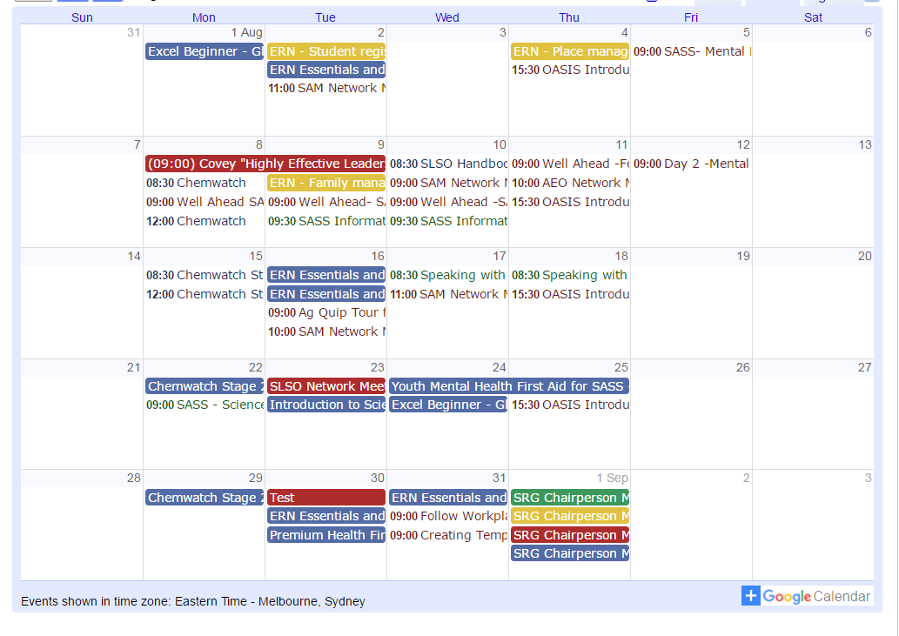
Professional development
SAS staff Reference Group (SRG)
Professional learning calendar
Notes:
The SAS staff Reference Groups (SRGs) schedule professional learning that caters for all categories of SAS and other non-teaching staff in schools across the state. Please refer to the professional learning calendar for events that may assist to build your skills.
The calendar and SRG committee contact details are available for all SAS staff and can be found on the School Administrative and Support Staff webpage on the DoE Professional Learning website which can be accessed via the portal, Inside the department A-Z.

Slide 22
Excellence in school administration
Contact us:
Jenny Jackson - 9266 8350
Julie Sando – 9266 8910
sass@det.nsw.edu.au

Slide 23
Leadership and high performance directorate
Activities

Slide 24
School administrative support staff
SAS staff study assistance
advertised each semester open to SAMs, SAOs, AEOs and SLSOs
study leave is available for up to 3 hours per week
relief may be payable to schools
More information available on professional learning website
Notes:
SAS staff Study Assistance - has anyone previously done study to support your role in the school if so did you apply for SAS staff study assistance
Study Assistance is advertised each semester and open to SAMs, SAOs, AEOs and SLSOs.
study leave is available for up to 3 hours per week, total amount of hours granted by the panel is dependent on the number of subjects being studied and where study is being undertaken for example TAFE or university - relief may be payable to schools please check the website for further details
More information available on the new professional learning website
Study assistance is available to other staff classifications contact HR for further information

Slide 25
SAMs priorities - Daily
Primary
authorise SAP carts
general staff supervision
front desk incl late early students
school emails
liaise with P & C etc
office management
contractors
monitor direct deposits
High
authorise SAP carts
sales orders
NFB receipts
oversee finance & communication with DP
general SAS supervision
office management
contractors

Slide 26
SAMs priorities -weekly
Primary
run ‘red dot’ report
finance filing
enter casual staff into eCPC
sales orders
confirmations in SAP
monitor excursion payments & report to teacher if required
attend staff & executive meetings
High
run ‘red dot’ report
monitor direct deposits and action as required
follow up unpaid invoices
journaling as required
finance filing
attend staff & executive meetings

Slide 27
SAMs priorities -monthly
Primary
sundry tax reconciliation and journal as required
reconcile Pcards
run SAP reports to monitor management of internal orders & local activities
run reports to ascertain overall financials and report to principal
follow up unpaid invoices
process not for banking receipts
High
sundry Tax reconciliation and journal as required
reconcile Pcards
Run SAP reports to monitor management of Internal orders & local activities
run reports to ascertain overall financials and report to principal
follow up unpaid invoices
process not for banking receipts

Slide 28
General duties
Primary
Primary
managing & monitoring of admin budget
organising & chairing SAS staff meeting
meet with principal re finance support
prepare finance reports for finance committee
plan SAS staff professional learning & PDPs
enrol students into UI/UIOs & process refunds
liaise with teachers re excursions etc
provide new casuals with paperwork
process temp teacher forms
manage SAS staff leave
High
managing & monitoring of admin budget
organising & chairing SAS staff meeting
meet with principal re finance support
prepare finance reports for finance committee
plan SAS staff professional learning & PDPs
run relevant reports for finance committee meetings
manage SAS staff leave/rosters etc

Slide 29
ongoing duties
Primary
Primary
manage yr 6 into 7 process including forwarding record cards
general training of admin staff
arrange stocktake
online data collections
manage insurance claims
manage employee forms eg SLSO on overnight excursion
manage staff claims
presentation day with team
audit reports as required
High
general training of admin staff
arrange stocktake
online data collections
manage insurance claims
manage staff claims
presentation day with team
audit reports as required

Slide 30
Team tasks - customer service
Establish an agreed set of team values and shared tasks that enhance customer service in the front office.
Team meeting agenda to look at our agreed team values to establish the top ten shared tasks for all staff working in the school office
Notes:
At a team meeting discuss duties that need to be attended to, on the spot, regardless of whos role it is
Eg. Parent at the front counter and receptionist is already on the phone. Another staff member needs to be able to attend to the query.
This is an example of a team value or a non negotiable within you staff.
In small groups come up with minimum of 5 examples.

Slide 31
I accept it is my responsibility to answer the phone within 3 rings-even if it isn’t my role
If another team member is not at their desk I will pick up their phone if it is ringing
I accept customer service is my responsibility. I will:
be friendly, helpful, prompt and polite
acknowledge the customer if I can’t attend to them straight away.
be available to all customers at the start of the school day by not checking emails etc between 8.30-9.00 am
I will fulfil my responsibilities on the daily list of duties.
I will communicate to my team when I leave the office by:
advising how long I will be
if appropriate, advising where I am going.
sign out of the school if leaving the grounds even on lunch break

Slide 32
I will be fair with my day by:
trying to work at my desk as much as possible
being supportive of the team in high volume workloads
filing and keeping the office tidy, stocked and organised.
arriving at work on time, ready to tend to counters and phones by starting time.
If I am having a personal conversation, I will STOP and serve if someone appears at the counter or the phone is ringing internally or externally.
I will not berate a team member behind their back if I have a work related issue with them. I will address it with them first, if unsuccessful I will address it with the SAM.

