Slide 1
Nirimba SAM Conference 2017 3 November, 2017
Presented by:
SAP Schools Finance
Manager – Michele Mills
Principal Finance Officer – Kathy Herron

Slide 2
What do we do?
Remedy
Assisting schools with troubleshooting and understanding
Monitoring Financial Management of SAP Schools
System Enhancements, Issues, UAT
Data Validation and Compliance
Representation on Working Groups
Cost Centre
Approvals & Maintenance

Slide 3
Today’s Session – Best Practice
Budgeting/
Financial Management
Cashdesk
Purchasing
Journals
Reallocation of Costs
Notes:
Budgeting/Financial Reporting
Cashdesk
Purchasing
Journals / Reallocating of costs

Slide 4
Budgeting/Financial Management
What’s involved
Be part of the budget/finance committee
Know what the school plan is
Ensure all transactions line up to the budget
Regular review meetings
Regular Housekeeping
Benefits
Decisions can be made to improve student outcomes
Accurate Reporting
Peace of mind
Evidence of decisions made / Transparency
Notes:
Schools are now holding 70% of the state budget. We are now seeing salary costs for the first time.
SBAR provides detail as to the program funding within the allocation.
Schools need to understand the impact on their school and the best way for them to manage it.
Once a school plan is developed this must be costed into the schools annual budget.
The budget should aim to spend all of the schools SBAR in that year if possible.
The budget once uploaded into SAP will provide the budget to variance reporting so your school will know how you are tracking.
The SAP reports will provided estimated funds available at year end based on this budget which could open up possibilities as the year progresses if you are tracking under budget
Paperwork,
SBAR
School Plan
Minutes of any budget meetings
Spreadsheets with budget prior to upload to SAP.
Record of any budget reviews.
Unplanned costs that arise through the year, can you afford it?

Slide 5
Budgeting/Financial Management
Paperwork
Schools Budget Allocation Report
School Plan
Minutes of any budget meetings
Spreadsheets of any budget planning
Record of budget reviews
SAP Reports – Schools Overview Report
Annual Financial Statement
Record of any journaling to align actuals to budget
Record of any variations to budget

Slide 6
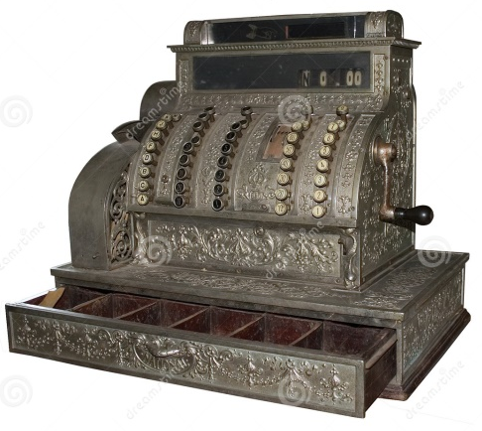
Cashdesk
Fee Type/Fee Values are setup according to the activity receipting funds for. eg. Scholastic Book Club
Receipt ALL payments in ebs:central ASAP.
Do not retain any credit card information.
Ensure all cash is reconciled and banked promptly.
Notes:
The Fee Value is what feeds the cost assigning to SAP.
Payment Card Industry Compliance (PCI)

Slide 7
Cashdesk
Banking Reports are signed by Approver
Check banked amounts against banking and cash report
Cancelled and adjusted fees reports produced every weekday
Record of any waivers, student assistance.

Slide 8
Purchasing
Ensure cost assigning for all purchases aligns to the school budget and or fee setup in ebs:central
Excursion, Extra-Curricular, Sport expenditure must be 6300 (unless school funded)
Retain quotes for asset purchases and upload these to the shopping cart. Refer to the QRG: How to purchase an asset (LMBR/Training/Finance(SAP)/Purchasing)

Slide 9
Purchasing
Review purchasing regularly
Purchase Order and Commitment Report – status of purchase order
Invoice Image Inquiry Report – status of invoice payment
Review outstanding commitments and any potential duplicate Purchase Orders.
Notes:
Duplicate Purchase are a liability to a school and can appear like your school has spent more then they should have.

Slide 10
Purchasing
Example of a potential duplicated purchase order
An outstanding unconfirmed purchase order which is similar to a previous purchase order

Slide 11
Purchasing
Example of a duplicated purchase order
A purchase order that has been confirmed but no payment made.
School has been charged $2340 (2 x 1170)
Notes:
Refer to the Adobe Connect session on Managing purchasing.
In this instance the confirmation will need to be cancelled on the second PO and then the PO edited and the line deleted and then reordered.
If the vendor is blocked on this purchase order assistance is required from EdConnect

Slide 12
Purchasing
QRG’s on Managing Purchasing
How to Change an existing Purchase Order
How to Cancel a Purchase Order
How to Cancel a Confirmation
How to Clear outstanding amounts on a Purchase Order
How to run the Purchase Order and Commitment Report
Invoice Image Inquiry Report
Instructional Clip – Managing Purchasing

Slide 13
Purchasing
P-Cards
When acquitting a purchase ensure the following are correct:
Fund –Relevant to the purchase eg. 6100
Cost Centre – Applicable to the cardholder or budget for that purchase.
General Ledger – please don’t use 524345 – Pcard Expense Clearing. (this account needs to balance to 0.00)
Consider having a SASS Staff member review or prepare the acquittal on behalf of the card holder

Slide 14
Purchasing
Manual Payment Forms
Manual payment forms do not validate the cost assignment entered. If the incorrect data is entered it may not be rejected by accounts payable but post to the incorrect area.
When completing any manual payment form please ensure the correct cost assigning has been entered before submission for payment.
Fund, Cost Centre and General Ledger - compulsory fields
Internal Orders – if an internal order number is used ensure it is available for your school to use.

Slide 15
Journaling / Reallocation of Costs
Clear Direct Debit Clearing Account (500030)
Reallocate Salary Costs:
2017 deployed schools will still receive CEPS bills
Schools deployed prior to 2017 will only journal salary costs so that budgets can be tracked
Correction of cost assigning errors - Please seek help if you are unsure
Interschool Journals – recovering costs from other schools. (Each journal must only contain 2 schools)

Slide 16
Journaling / Reallocation of Costs
Always keep relevant documentation to substantiate the journal required
Upload this documentation to the journal
An approver should not approve a journal unless there is documentation attached
Training material to assist with journals:
/LMBR/Training/Finance (SAP)/Journal Entries

Slide 17
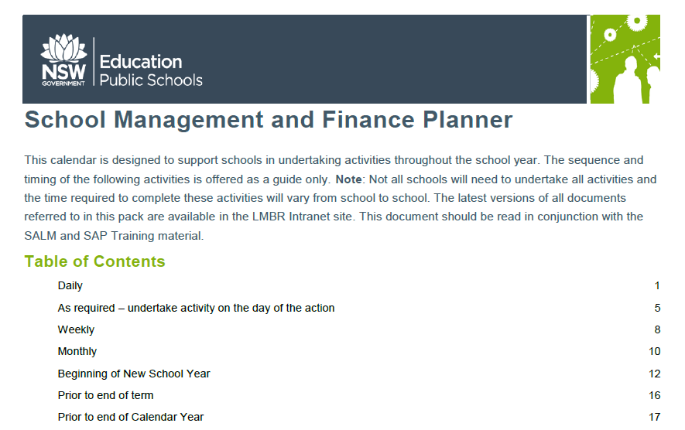
Review Finance Planner
/LMBR/Training/Finance(SAP)

Slide 18
SAP Schools Finance
1300 32 32 32
Email: SAP Schools Finance
(~corporate.sapschoolsfi518@det.nsw.edu.au)
When seeking assistance please log a Remedy Incident and ask for Schools Finance
Our team is 2nd level support.
Please don’t call 13 10 72, this number will longer be available in 2018

