Slide 1
Probity UNIT
Working with Children Check
Compliance Requirements

Slide 2
Compliance Requirements
EDM sent 28/06/2017
SMS sent week commencing 3/07/17
The department has adopted a policy position that all teaching and non-teaching staff employed in our primary, central, infants, community, SSP, EEC and hospital schools must provide their WWCC clearance before 17 November 2017.

Slide 3
Compliance Requirements
Any teacher who has not provided a WWCC clearance to the department by
17 November 2017 will not be eligible for accreditation by NESA from 2018.
Any school based non teaching employee who has not provided a WWCC clearance to the department by 17 November 2017 will not be eligible for employment with the department in 2018.

Slide 4
At A Glance Figures
Primary School Staff @ 02/08/17 | Count (Teaching and Non-Teaching) | WWCC Clearances RECEIVED | % RECEIVED WWCC Clearances | WWCC Clearances YET TO BE PROVIDED | % WWCC Clearances YET TO BE PROVIDED
Total | 68,754 | 52,580 | 76.48% | 16,174 | 23.52%

Slide 5
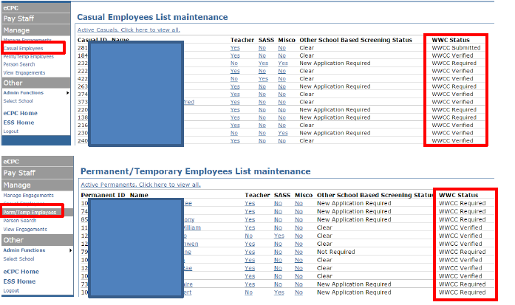
Compliance Requirements
How do I check that my staff have supplied their WWCC number?

Slide 6
Compliance Requirements
How do I check if staff have input their WWCC number?

Slide 7
how to apply for a WWCC CLEARANCE

Slide 8
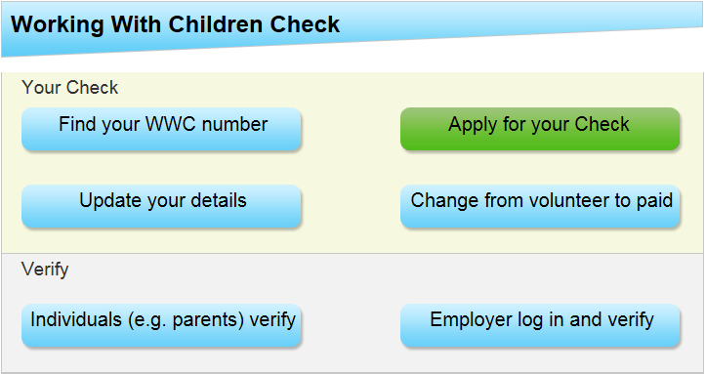
How to apply for WWCC CLEARANCE
http://www.kidsguardian.nsw.gov.au/working-with-children/working-with-children-check/apply/apply

Slide 9
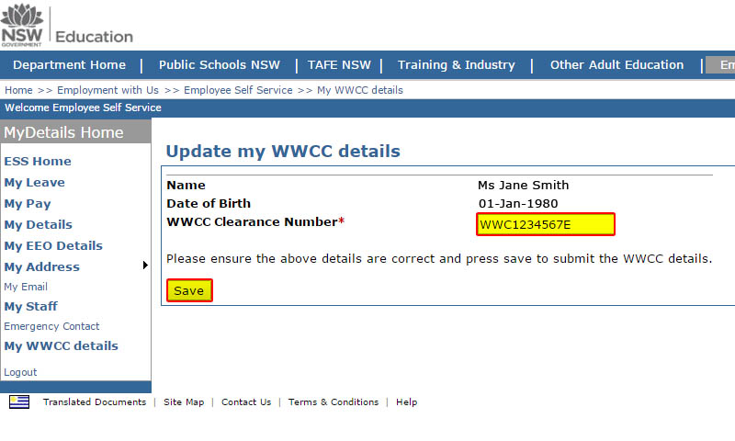
How do staff provide their WWCC number?
Staff need to provide their WWCC number via the Employee Self Service (ESS) portal.
Step 1:Log into the ESS portal.
Step 2:Select “My details”, then select “My WWCC details”.
Step 3:Enter your WWCC clearance number as issued by the Office of the Children’s Guardian (e.g. WWC1234567E).

Slide 10
Volunteers required to provide a WWCC
Any volunteer :
Working as part of a formal mentoring program or
Involved in intimate, personal care of children with a disability or
Who is not a parent or close relative of a student at the school at which the volunteer is working
is required to obtain a WWCC.
These people need to provide the school with a valid WWCC number (paid or unpaid), complete Appendix 11 and 100 points of ID. The school then screens the person via eCPC as a volunteer/contractor in order for the verification process to take place.

Slide 11
Volunteers exempt from providing WWCC
The majority of parents or close relatives who volunteer with their child's school are exempt from obtaining a WWCC, and will continue to be exempt.
This means the day to day reading helpers, canteen helpers etc, who are a parent or close relative to a child at the school, are NOT required to provide a WWCC number. Please Note: These positions are not classed as formal mentoring. They need to complete the Appendix 5 and provide the school with 100 points of ID.
This information should be used to check the NTBE information via eCPC. These people should not be established on eCPC. You just need to search their name in ‘person search’ to ensure they are not on the NTBE database.
Anyone who is under the age of 18 is exempt from obtaining a WWCC clearance. Any enquiry relating to workers or volunteers under the age of 18 should be referred to the Probity Unit on 9836 9205 or wwcc@det.nsw.edu.au

Slide 12
Contractors engaged LOCALLY
Please note: Maintenance Contractors hired by the NSW Department of Education are managed separately - Schools are not required to undertake any screening for these workers.
All adult contractors engaged locally who will be engaged in child-related work need to have a valid WWCC clearance. These contractors include people who are paid by the school or the P & C, such as sports coaches, band/music tutors, drama coaches, choreographers, class tutors, canteen managers and project or special program facilitators.
These people need to provide the school a valid WWCC number (paid), 100 points of ID and complete Appendix 11. Then the school screens the person by eCPC as a volunteer/contractor in order for the verification process to take place.

Slide 13
Contractors Exempt from providing a wwcc – non child related - engaged locally
Exceptions are:
anyone under the age of 18,
contractors who only perform maintenance or ancillary work outside of school hours, and
any other contractors who will not have contact with children for extended periods.
These contractors are required to complete Appendix 5 and provide 100 points proof of ID before commencing any work on school premises.
For subcontractors or employees of a contractor (i.e. a person engaged by a third party, not by the school directly), the contractor needs to confirm to the Principal in writing that the subcontractor or employee has met any relevant requirements under the Child Protection (Working with Children) Act 2012 before the person commences work on school premises. Names and DOBs should be provided in writing so that a search of the NTBE database can be carried out in eCPC.

Slide 14
SRE / SEE
Approved Providers of Special Religious Education (SRE) and Special Education in Ethics (SEE) are responsible to recruit, train, and authorise SRE/SEE teachers. This includes verifying the Working with Children Check Clearance.
Schools do not collect 100 points of ID nor do they verify the WWCC.
The approved provider must submit to the school a list of the names and contact details of local representatives and authorised teachers before the commencement of SRE in 2017.
Additionally, providers will be required to supply the date of birth of their SRE/SEE personnel to the school before 31 March 2017. The addition of the date of birth to the list will allow schools to check the department’s NTBE database in eCPC.
Schools will be required to cross-reference authorised teachers on eCPC before the commencement of Term 2, 2017.
SRE/SEE teachers are required to present photo identification upon request by the school. SRE/SEE teachers must also be issued by the approved provider a name badge that includes the name of the authorising approved provider. The name badge must be worn at all times whilst on a school site.

Slide 15
STATE GOVERNMENT EMPLOYEES WITH STATE GOVERNMENT ID
State government workers such as NSW Health and NSW FACS employees are required to show their government issued ID (which will display the NSW Government Waratah emblem) on each visit to the school. Additionally, they are required to show a Driver’s Licence or RMS Proof of Identity card in order to verify their date of birth. This information should be noted in the visitor register and used to check the NTBE database though person search in eCPC on each visit to the school.

Slide 16
SCHOOL CLEANERS
Prior to the start of each semester, the cleaner’s employer (e.g. Spotless or Menzies) will confirm in writing to the principal that the person has met relevant requirements under the Act and provide the cleaner’s full name and DOB for a NTBE database search
School’s do not collect 100 points of ID nor do they verify the WWCC for cleaners.
We are currently working closely with staff from the Asset Management Directorate on significant enhancements to the WebClean system.
It is anticipated that these improvements will commence roll out over the next few weeks.

Slide 17
Which visitors to the school do not need to have a WWCC clearance?
Parents and close relatives of students visiting the school do not need to hold a WWCC clearance or complete a WWCC declaration before visiting the school
Local Members of Parliament, city council officials, journalists, media or guests invited by the school on special occasions (for e.g. speakers at the school assembly or an adjudicator) do not need to hold a WWCC clearance nor complete the any appendices
Representatives of industrial organisations including the Teachers Federation and the PSA.

Slide 18
SCHOOL VISITORS WHO ARE EMPLOYEES OF THE NSW Department of EDUCATION
Corporate staff in non-child related positions are not required to have a WWCC in order to visit a school as they are not performing unsupervised work with children for extended periods of time.
These staff are treated as a visitor to the school, calling at the office to sign in and show identification if requested. These staff will then conduct, or participate in, the required activity and then leave the school.
Examples of these staff include Property NSW Cleaning and Maintenance Inspectors, HR staff conducting L&D activities.

Slide 19
Ocg request for a reference
If a principal or other workplace manager is asked to provide a reference as part of a WWCC clearance risk assessment they should complete all sections, apart from part 6 of the Office of the Children's Guardian (OCG) employer reference form and sign the form.
The reference should then be referred to the Executive Director, Employee Performance and Conduct Directorate (EPAC) so that part 6 can be completed and the reference approved. EPAC will return the completed document to the OCG.
You should not provide a copy of the reference to the employee.

Slide 20
ID DOCUMENTS
NSW public schools have comprehensive guidelines which comply with the Payment Card Industry Data Security Standard (PCI DSS). This policy says, in part, that customer credit/debit card data must never be written down or stored.
When credit/debit cards are used as identification, only the front of the card is to be copied and the numeric details of the cards are to be obscured with only the names to remain visible.
The identification documents must be securely kept by the school for seven years post engagement and then disposed of in a secure manner, such as shredding.

Slide 21
Teacher employment agencies
Employment agencies such as Ranstad and ClassCover are simply matching agencies between schools and workers.
The schools using these agencies need to be aware that just because a worker is referred to a school does not mean they have an Approval to Teach in NSW public schools.
Prior to engaging a teacher referred by an agency, please ensure the worker is showing in eCPC as
Teaching Approval Current - Available for engagement
And
WWCC clearance has been verified WWCC Recheck Date - dd-mm-yyyy
Naturally you must see photo ID such as a Driver's Licence if the worker is unknown to you.

Slide 22
FREQUENTLY ASKED QUESTIONS
FAQs can be found at
https://education.nsw.gov.au/human-resources/recruitment/probity/working-with-children-check/faqs
Policy documents (including Appendices) can be found at
https://education.nsw.gov.au/policy-library/policies/working-with-children-check-policy?refid=285855

Slide 23
Contact US (These numbers are for internal use only-please don’t provide them to the public)
Probity Unit
Fiona Towney 9836 9205
Lead
Cheryl Fraser 9836 9290
Senior Advisor
Laurene Adams 9836 9995
Officer
Shelley Sloane 9836 9201
Officer
Lauren Day 9836 9202
Officer
Perla Madriaga 9836 9061
Support Officer
Email: probityunit@det.nsw.edu.au
wwcc@det.nsw.edu.au

Slide 24
Forum - Questions and Answers
Questions?
Comments?
Suggestions?

